Slide 1
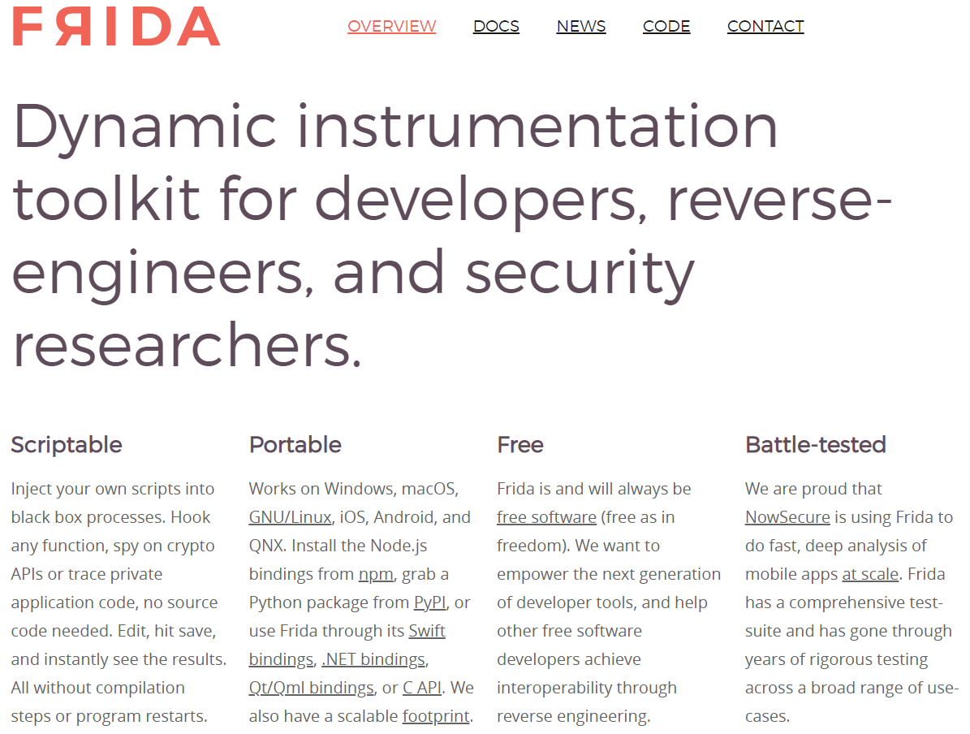
https://frida.re/

Slide 2
Advantages of Frida
Uses REPL concept
Read-Eval-Print-Loop
Scriptable
Runtime tracing of:
Classes
Methods
Parameters
Return values
Read
Print
Eval

